Slide 1
Deep Learning for Alcohol Recognition
Joseph Bernstein & Brandon Mendez

Slide 2
Table of Contents
-Introduction
-System and Implementation
-Results
-Future Work

Slide 3
Table of Contents
-Introduction
-System and Implementation
-Results
-Future Work

Slide 4
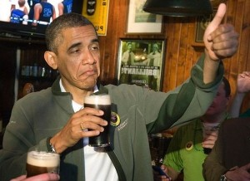
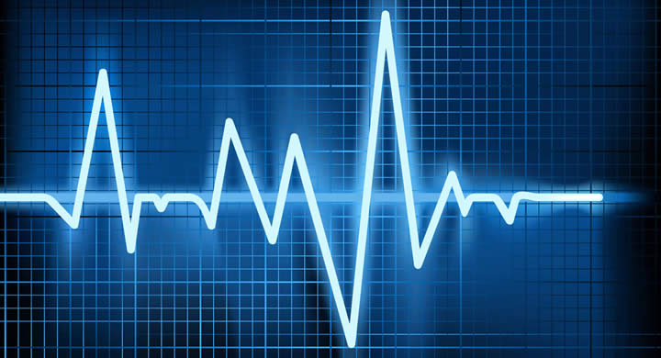
Motivation
After drinking, physical changes occur in the body to be able to handle the digestion of alcohol
Can this information be used to detect whether or not someone has consumed alcohol?
Why does this matter?
Notes:
Who cares: if drinking can be determined by simple sensing, such as temp, hr, br, or activity, then it opens a wide array of ways to study the habits of people who drink

Slide 5
The Solution
Excel Spreadsheet (store data)
Convert data to Spectrograms
(with Python script)
Generate visual portrayals of the sensor data (in the form of a Spectrogram)
Train a Convolutional Neural Network (CNN) using the generated Spectrograms
Test the CNN to see results
Wearable Sensors
Deep Learning with Caffe (Amazon AWS EC2 Server)
Output:
Whether or not the person has been drinking

Slide 6
Table of Contents
-Introduction
-System and Implementation
-Results
-Future Work

Slide 7
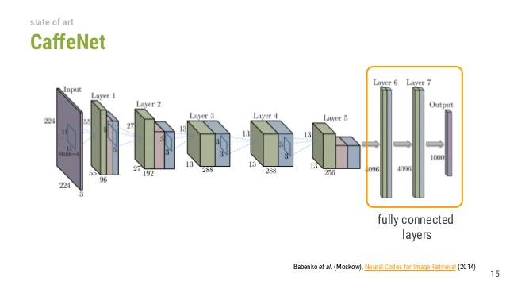
CaffeNet
Scales any image to 224x224 as input
Take various subsections of image to find features
Functions as “black box”

Slide 8
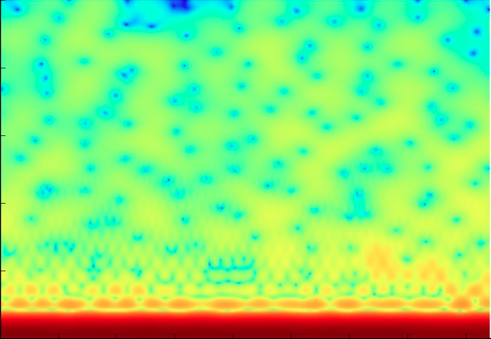
The Spectrogram
NFFT: 50, Number of Datapoints in each calculation
Fs: 0.2, Sampling Frequency, based off of time segments in the original data
Noverlap: 49, Overlap of each calculation
Pad To: 256, used for increasing number of calculations (more data points).
Frequency (Hz)
Time (s)
plot.Spectrogram(Datapoint=Data, NFFT=50, Fs=0.2, Noverlap=49, Pad_To=256)

Slide 9
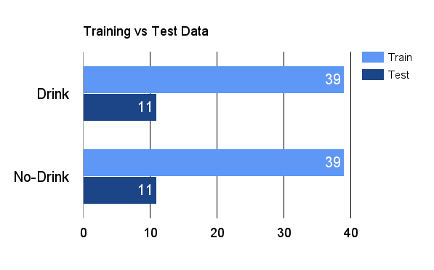
The Data Used
Drink | 50 Spectrograms
No-Drink | 50 Spectrograms
Training Data | 39 Drink 39 No-Drink
Testing Data | 11 Drink 11 No-Drink
Data Collected | MCMRT
Data Points | 1,077,967
Spectrograms Generated In | Python’s MatPlotLib and MATLAB

Slide 10
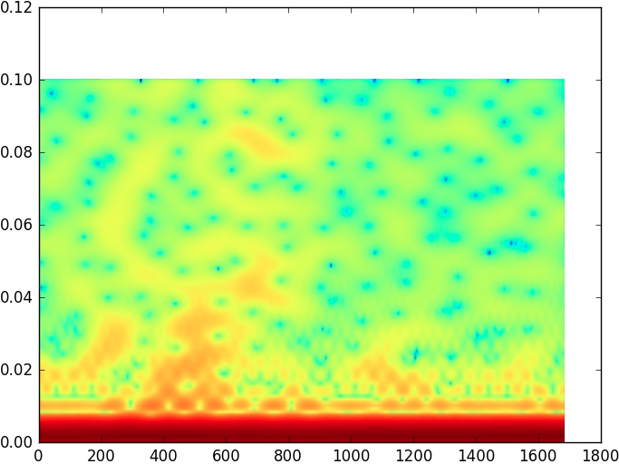
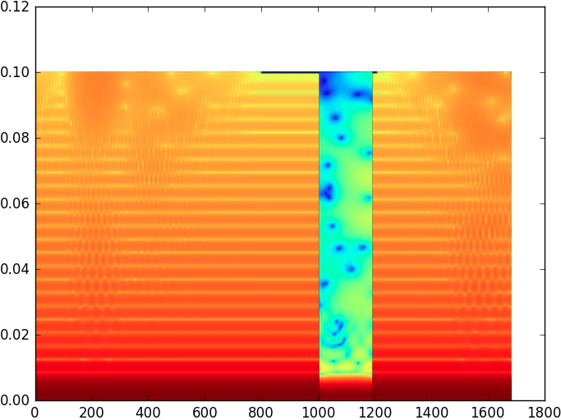
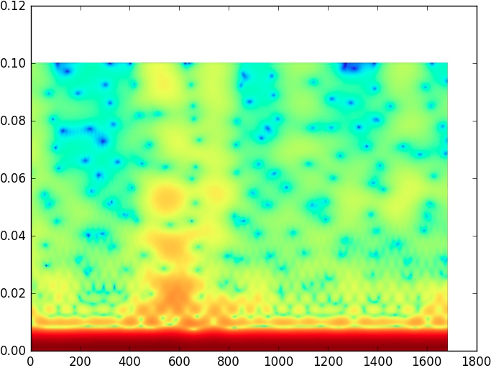
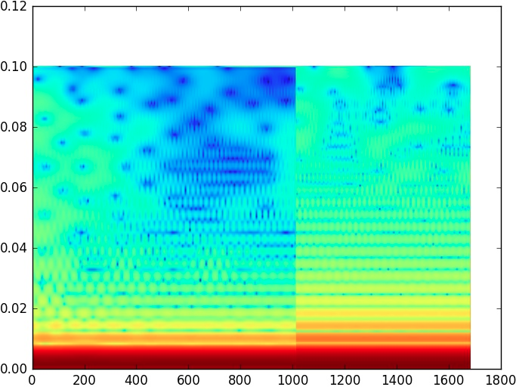
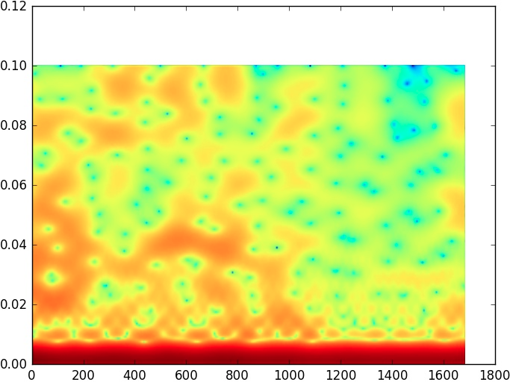
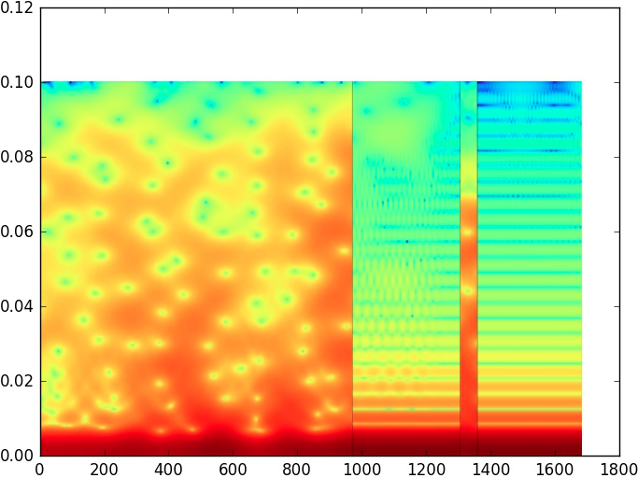
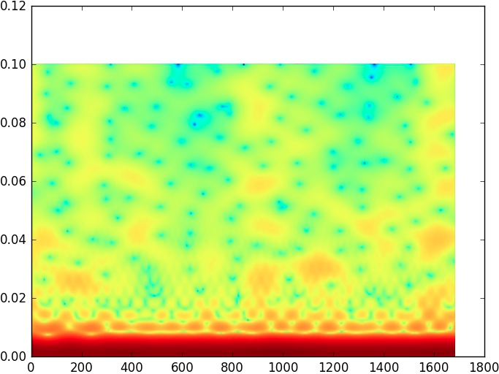
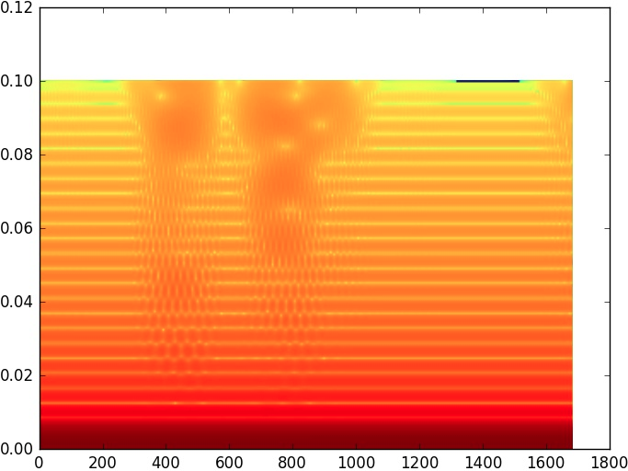
Example Spectrograms
Drink Spectrograms No-Drink Spectrograms

Slide 11
The ‘Drinking’ Spectrogram Algorithm
The ‘No Drinking’ Spectrogram
GET data FROM excelSheet
PUT data INTO table
DROP EACH row IN table WHERE there is no instance of drinking
FOR EACH row IN table of drinking instances
GET all points IN original dataset
REMOVE all in dataset EXCEPT those within 60 minutes of the drink point.
PLOT points
GET data FROM excelSheet
PUT data INTO table
DROP FROM table WHERE row was used for Drinking Spectrograms
WHILE(number of ‘No Drink’ Spectrograms ≠ number of ‘Drink’ Spectrograms)
GET random date/time, select random 60 minute time window
IF (random date/time NOT missing data)
PLOT points

Slide 12
The ‘No Drinking’ Spectrogram
Store Data in a table
Drop rows from table that were used for the Drinking Spectrograms
While the number of ‘No Drink’ Spectrograms is not equal to ‘Drink’ Spectrograms
Get a random date and time, and select a 30 minute time range from the table
If the random date and time range is not missing data
Plot the spectrogram

Slide 13
Table of Contents
-Introduction
-System and Implementation
-Results
-Future Work

Slide 14
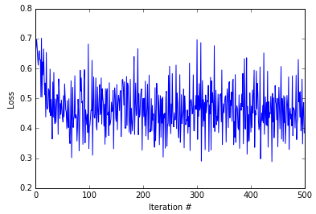
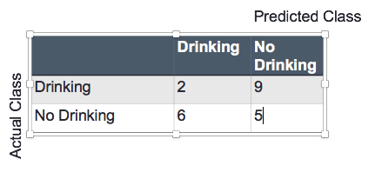
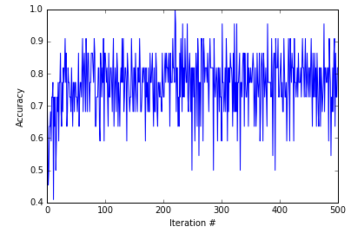
Results - Standard CaffeNet
Loss | .384
Training Accuracy | 82%
Overall Accuracy | 32%

Slide 15
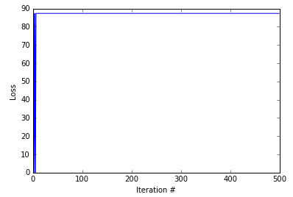
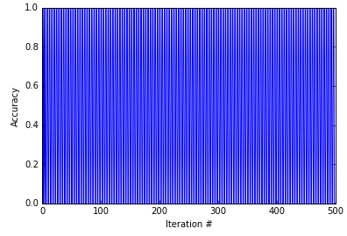
Initial results
Overall Accuracy: 45%

Slide 16
Initial Results
Learning rate was too high
Caffenet was being shown spectrograms but was not given enough time to learn the spectrograms
Key to more accurate results is lower learning rate so Caffenet has more time learn spectrograms

Slide 17
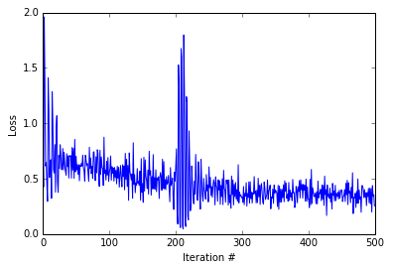
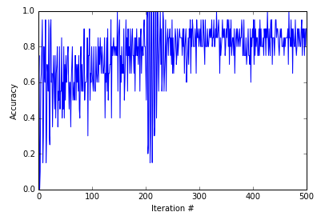
Learning rate adjustment
Overall Accuracy: 55%

Slide 18
Learning Rate Adjustment
Results look better but could still go up so I decide to change gradient descent
Gradient Descent is a first-order optimization algorithm to find a local minimum of a function
Initially I used the default gradient descent which is SGD but decided to try Adam

Slide 19
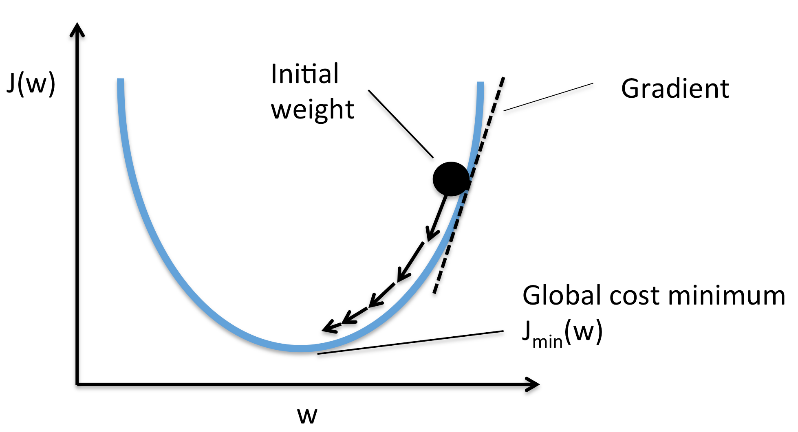

Slide 20
Gradient Descent
Relates to caffenet because gradient descent will make many small iterations towards the local minimum
For deep learning this means iterations towards editing the weights getting closer to the highest accuracy

Slide 21
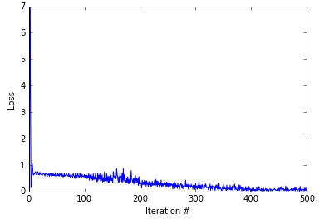
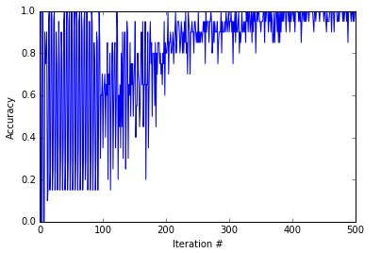
Adam Algorithm
Overall Accuracy: 65%

Slide 22
Loss Layer
Search for more parameters to change and start to research loss layer
Loss Layer drives learning by comparing a predicted target to an actual output and assigning cost to minimize weights
I have been using Softmax as my loss layer and I changed to Hingeloss to observe the results

Slide 23
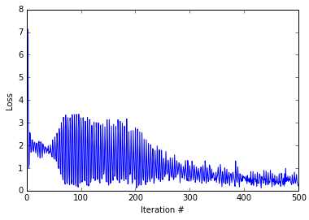
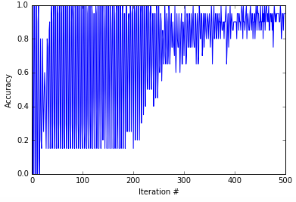
Hingeloss
Overall Accuracy: 65%

Slide 24
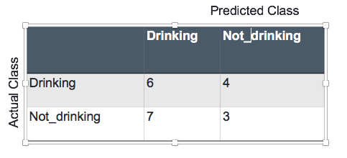
Confusion Matrix

Slide 25
What is the correct frequency for heart rate
We were inspired by waveforms of speech
We know what range the frequency of waveforms of speech usually occur at however, we have no idea how what that range is for heart rate
How can we find that range?
The solution is using feature vectors

Slide 26
Feature Vectors
Feature vectors show what caffenet is seeing when it is shown an image
It can show where exactly it is extracting the most features from an image which in this case would mean show where the frequency range is

Slide 27
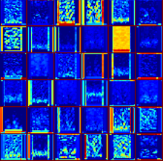
Feature Vectors

Slide 28
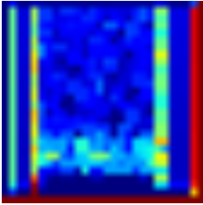
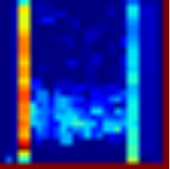
Good

Slide 29
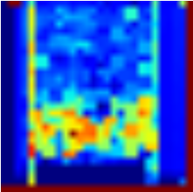
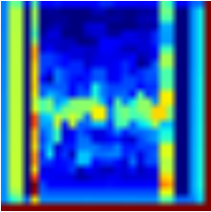
Good

Slide 30
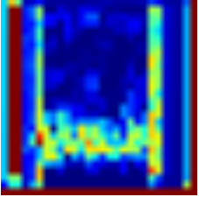
Good

Slide 31
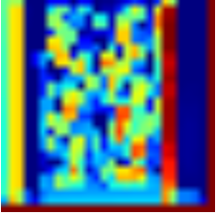
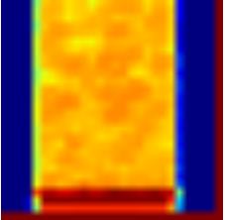
Bad

Slide 32
Table of Contents
-Introduction
-System and Implementation
-Results
-Future Work

Slide 33
Future Work
Spectrograms
Logarithm Scale
Zoom on Frequencies/Time Window
Gray Scale
CNN
Determine which Spectrograms are not properly identified
GoogleNet
Test with other Spectrograms generated from Python

Slide 34
Questions?

